Slide 1
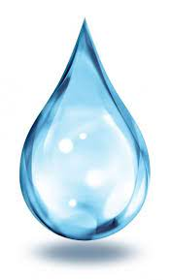
Water ATM
Water is a basic necessity of humankind ,it comprises of 71% of earths surface still
only 2.5% exists as fresh water and of that only 0.3% percent in liquid state,
Despite being such a precious asset years of negligence and overpopulation has
left both ground and surface water resources in a dire stait ,
Hence there is an urgent requirement to come up with solutions that encourage
an equitable and efficient distribution of water to all in a risk free manner.

Slide 2
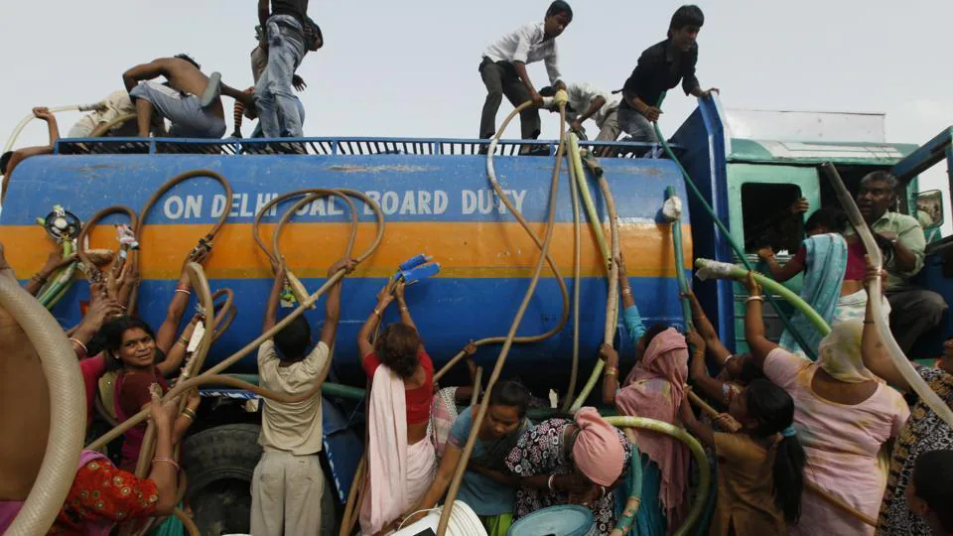

Crisis of our Times
What we see in above picture is true reality of some of our major cities where
some of the poorer colonies don’t get adequet water supply in summer months
which forces the residents to undertake a dangerous task of jostling and fighting
among each other which leads to
Inefficient and inequitable distribution of water
Dangerous in covid times
Daily Time wastage of people affecting their social life.

Slide 3

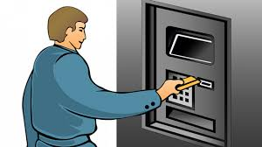
Finding The Solution
A Real ATM machine
Thus we came up with an idea of a Water ATM machine which works pretty much like a normal ATM machine instead it dispatches water at request of customer .
It would ensure a direct and measured supply to each and every household thus saving their time and effort in order to get water,It would a require a software portal which would identify the customer by a unique
ID and a central tanker catering to whole colony would deliver required amount of water with the help of
Aurdino based system .We think it would be a efficient solution in solving the problem.
It can also be later modified into delivering measured ground water preventing ground water erosion.

Slide 4
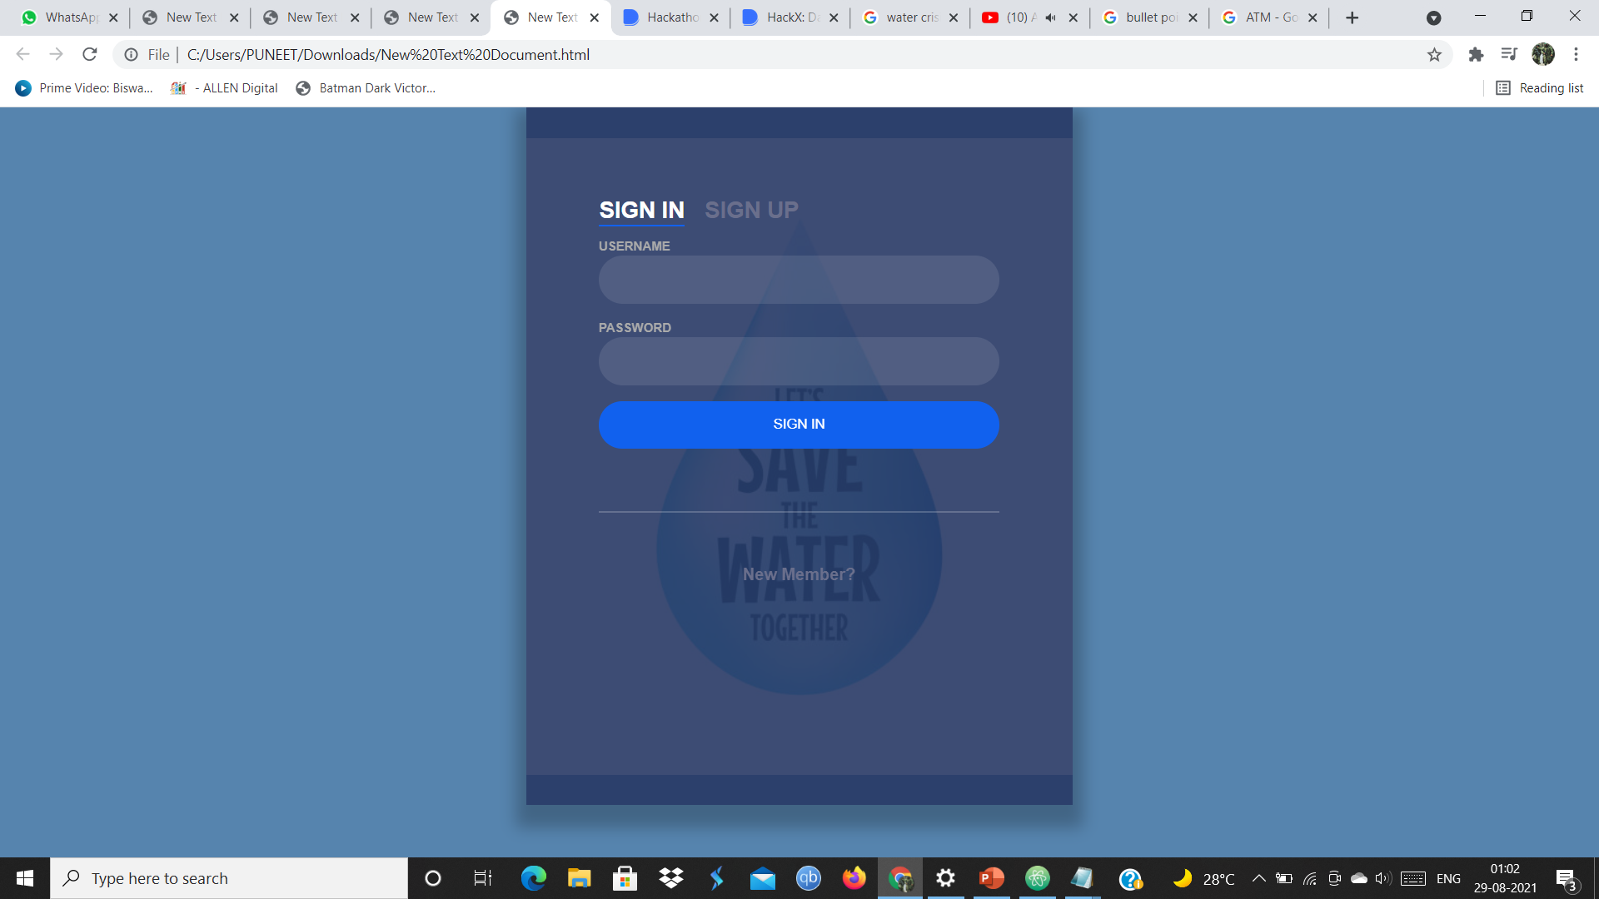
Working
Software part
1.)At first we create a sign in portal in which the user will have to enter his/her unique id to get entry into next page .

Slide 5
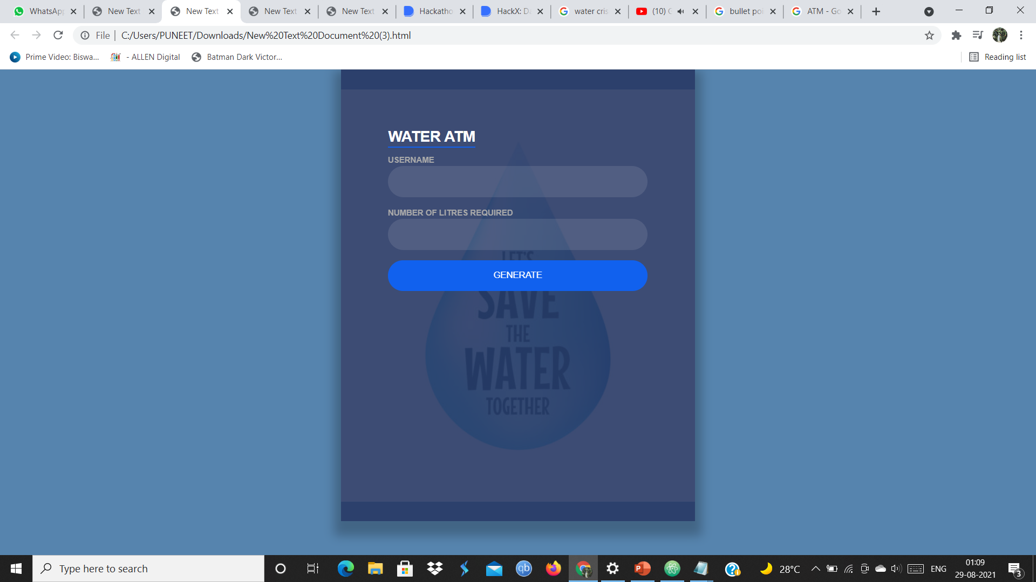
2.)After entering correct id user moves to next page which requires him to enter his immediate
Water requirement in litres.and then click on generate
3.)After the transaction is complete the user his directed to his profile which will display his transaction history and total daily capacity.

Slide 6

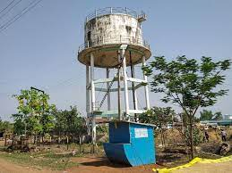
Hardware Part
In Hardware part we require a central tank which will which will be connected to every house through pipes
After receiving command , x amount of water will have to be measured and delivered with the help of an aurdino
Working of aurdino is explained in next slide.

Slide 7
Working to central tank system and aurdino
By using a flow sensor with a microcontroller like Arduino, we can calculate the flow rate, and check the volume of liquid that has passed through a pipe, and control it as required
YF-S201 water flow sensor uses hall effect to sense the flow rate of the liquid.
The Working of the YFS201 water flow sensor is simple to understand. The water flow sensor works on the principle of hall-effect. Hall-effects the production of the potential difference across an electric conductor when a magnetic field is applied in the direction perpendicular to that of the flow of current. The water flow sensor is integrated with a magnetic hall-effect sensor, which generates an electric pulse with every revolution. Its design is in such a way that the hall effect sensor is sealed off from the water, and allows the sensor to stay safe and dry.
According to YFS201 Specifications, the maximum current it draws at 5V is 15mA, and the working flow rate is 1 to 30liters/minute. When the liquid flows through the sensor, it makes contact with the fins of the turbine wheel, which is placed in the path of the flowing liquid. The shaft of the turbine wheel is connected to a hall-effect sensor.
Due to this, whenever water flows through the valve it generates pulses. Now, all we have to do is to measure the time for the pluses or to count the number of pulses in 1 second and then calculate the flow rates in liter per hour(L/Hr) and then use simple conversion formula to find the volume of the water which had passed through it.

Slide 8
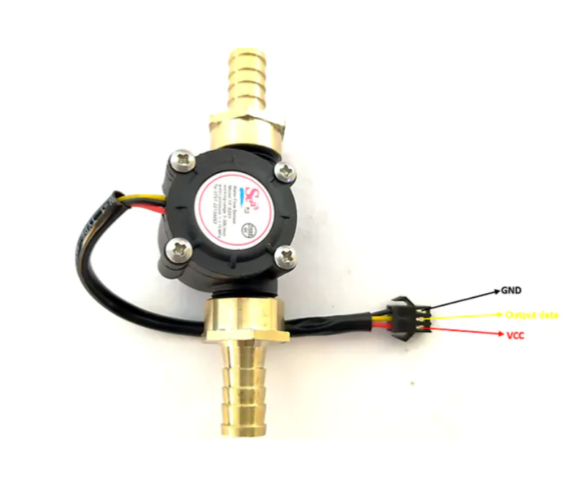
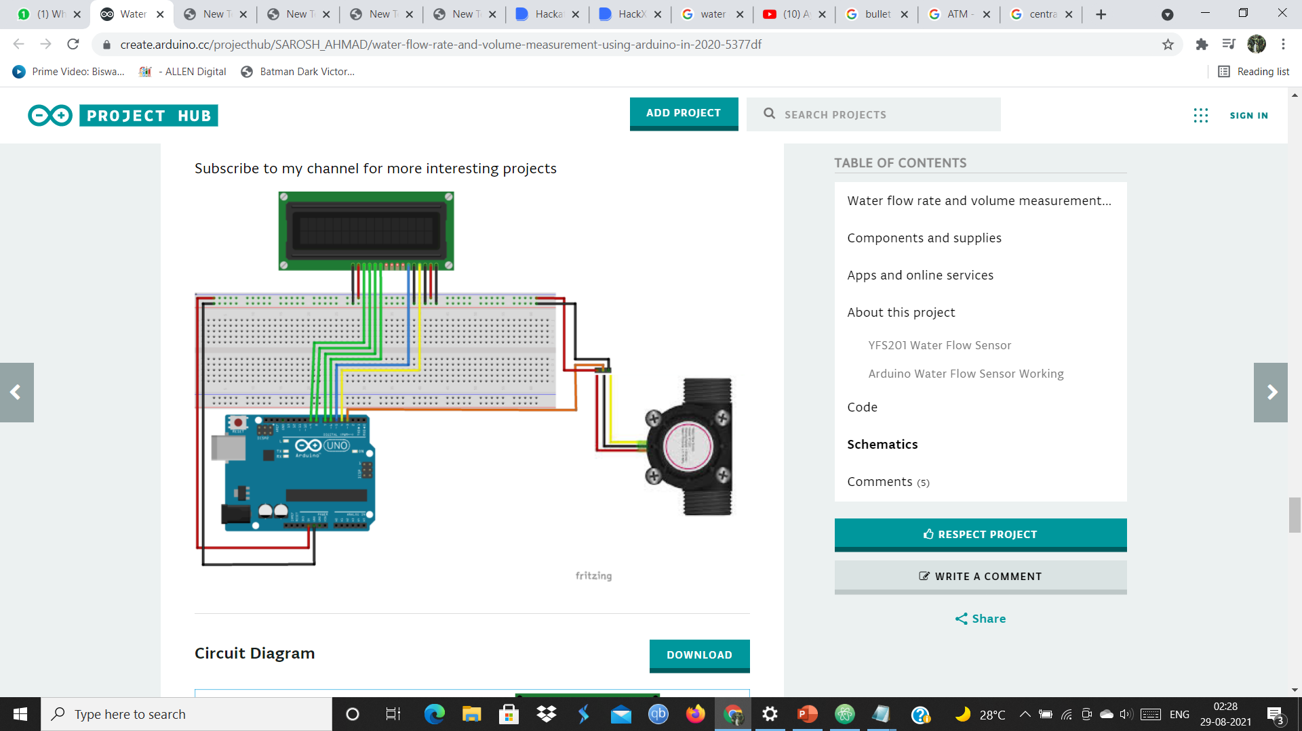
A YF-S201 sensor
Schematic diagram

Slide 9


